Slide 1

Active Record Associations
Has_Many and
Belongs_to
Presented by Ashish Kumar

Slide 2

What is Has_many?
A has_many association is similar to has_one , but indicates a one-to-many connection with another model.

Slide 3
Tables
Employees
Company
Ashish
PlanetSpark
Abhishek
Sumit
TechSophy
Navin

Slide 4
Create Table Campany
$ rails g model company name:string
Model Created
class Company < ApplicationRecord
has_many :employees,

Slide 5
Create Table Employee
$ rails g model employee name:string
Model Created
class Employee < ApplicationRecord
belongs_to :company

Slide 6
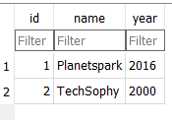
Company

Slide 7
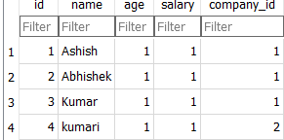
Employee
Company_id is foreign key in this table

